Slide 1
CIS 542
Digital Forensic
Topic: DeepFake Detection
Ajmal Abbas
Vishnu Selvaraj

Slide 2
Abstract
The widespread use of deepfake videos, which edit or produce hyper-realistic digital content using sophisticated generative techniques, has sparked serious concerns in fields including cybersecurity, media integrity, and digital forensics. Deepfake detection's ramifications for fraud, deception, and privacy violations have made it a crucial area of research. In this work, we suggest a strong framework for identifying deepfake videos that makes use of deep learning methods. To efficiently assess spatial and temporal aspects in video input, the model combines Long Short-Term Memory (LSTM) networks, Convolutional Neural Networks (CNNs), and attention processes. We use actual and synthetic video datasets, it’s from Celeb-DF dataset, to train and assess the model. To normalize input data, we use preprocessing techniques. The model's effectiveness is demonstrated by its excellent accuracy in differentiating between authentic and fraudulent videos.
This study contributes to the larger subject of digital forensics by demonstrating how deep learning may be used to address deepfake issues and offer a scalable method for identifying tampered media.

Slide 3
INTRODUCTION
The rapid advancement of generative techniques has led to the proliferation of deepfake videos, which can produce hyper-realistic digital content by manipulating audio-visual elements. While such technology has transformative applications in entertainment and education, its misuse has raised serious ethical and security concerns in domains like cybersecurity, media integrity, and digital forensics. Deepfakes pose a significant threat by enabling fraud, deception, and privacy violations, making their detection an urgent challenge. To address these risks, researchers are increasingly turning to deep learning methods that leverage the strengths of neural networks in pattern recognition and data analysis. In this study, we propose a robust deepfake detection framework that integrates Convolutional Neural Networks (CNNs), Long Short-Term Memory (LSTM) networks, and attention mechanisms. This hybrid model is designed to effectively analyze the spatial and temporal patterns in videos, enabling accurate identification of manipulated content. Using the Celeb-DF dataset, which includes both authentic and synthetic videos, we demonstrate how preprocessing and deep learning techniques can contribute to the critical task of deepfake detection in digital forensics.

Slide 4

Need of study
The validity of digital media is seriously threatened by the quick development of deepfake technology, which might be abused for identity theft, defamation, and disinformation operations. The increasing complexity of deepfake algorithms frequently outpaces current detection techniques, making the creation of reliable and scalable solutions necessary. This study uses deep learning approaches to assess temporal and spatial anomalies in video data, addressing the pressing demand for efficient detection systems. This study intends to improve media integrity, aid digital forensics, and lessen the security and social threats posed by deepfakes by offering a trustworthy framework for detecting manipulated information.

Slide 5
Objectives
To Create a Strong Detection Framework:
Create and put into use a deep learning-based framework that combines Long Short-Term Memory (LSTM) networks with Convolutional Neural Networks (CNN) to identify deepfakes by detecting temporal and spatial irregularities in video frames.
To Integrate Attention Mechanisms:
To increase feature extraction and the model's capacity to concentrate on crucial areas of video frames that can point to deepfake changes, use attention mechanisms.
To Data Processing and Augmentation:
Create effective preprocessing approaches to extract reliable video frame sequences, and employ augmentation strategies to strengthen the model's resistance to different perturbations.
To performance Evaluation and analysis:
Evaluate the model's performance by comparing it to current state-of-the-art techniques using common measures like accuracy, precision, recall, and F1-score.

Slide 6
To Assist Law Enforcement and Digital Forensics:
Professionals in Recognizing Deepfake Content and Maintaining Media Authenticity by Offering a Scalable Solution.

Slide 7
Base Paper:
The research paper titled "Deepfake Detection Using Machine Learning Algorithms" investigates the effectiveness of traditional machine learning (ML) techniques in detecting deepfakes. Here's a breakdown of the key points:
Methodology:
The authors propose a system using traditional machine learning for deepfake detection.
They combine various features like HOG, Haralic, Hu Moments, and Color Histogram features to create a unique feature set.
A two-stage approach is used to split the task: object detection (identifying all possible objects) and object recognition (identifying relevant objects).
This method offers advantages like better interpretability, reduced training time, and comparable or superior performance to deep learning approaches.
Results:
The reported accuracy achieved on several deepfake datasets is:
  99.84% on FaceForensics++
  99.38% on DFDC
  99.66% on VDFD

Slide 8
Limitations:
The paper doesn't mention the specific machine learning algorithms used.
It doesn't elaborate on the computational resources required for training the ML model compared to deep learning methods.
Overall, the paper suggests that traditional machine learning can be a viable approach for deepfake detection, offering good accuracy and interpretability.

Slide 9
Proposed Methodology
User Video
Preprocessing
Training and Testing
Prediction
Real or Fake

Slide 10
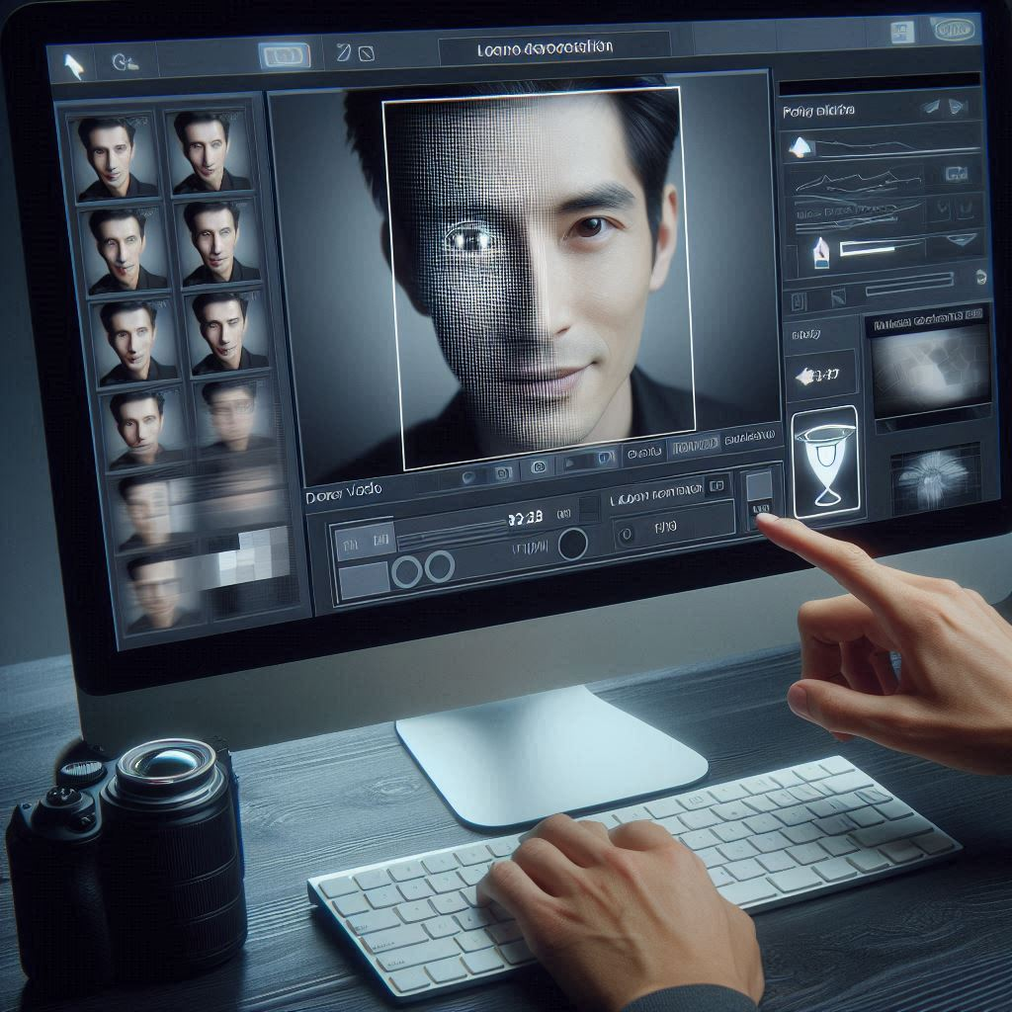
User Video:
A user-provided video, which may or may not be authentic, serves as the system's input.

Slide 11
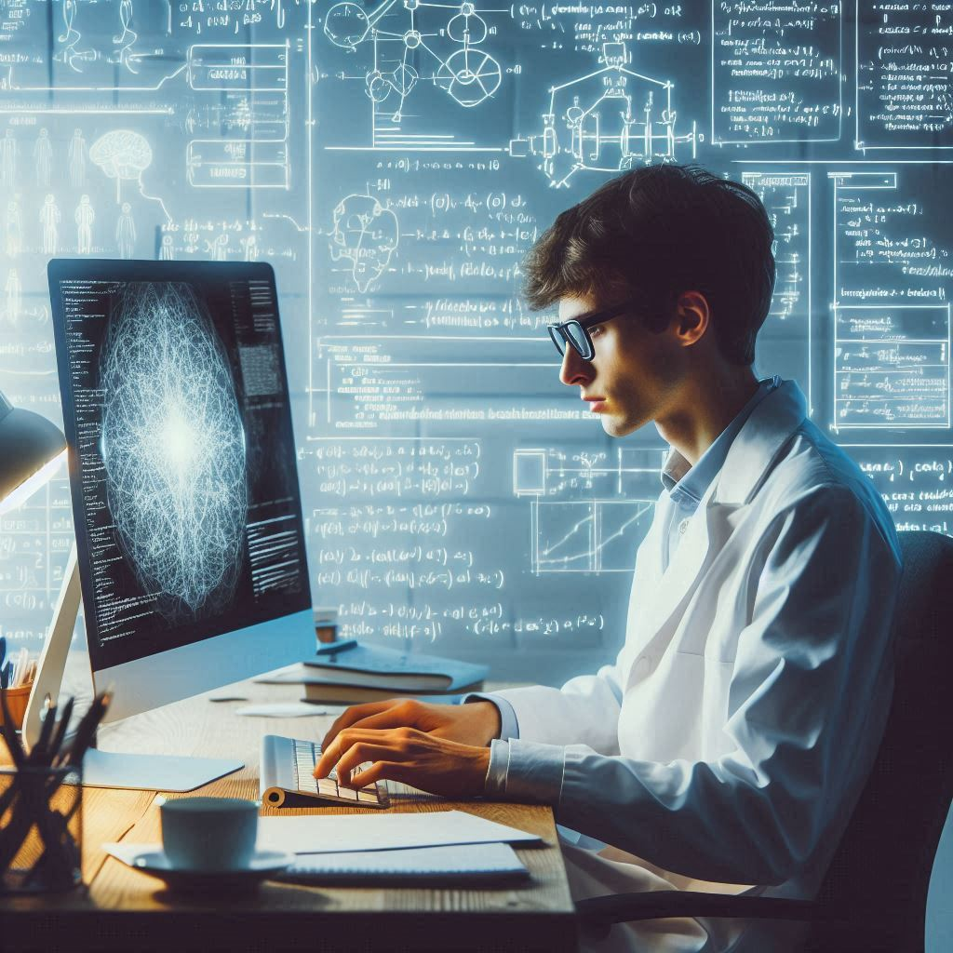
Preprocessing:
In this stage, frames from the incoming video are extracted and resized to a standard size (such as 224 by 224 pixels). Padding strategies are used to guarantee consistent frame sequences if there are not enough frames. Normalization and getting the data ready for additional analysis are also included in preprocessing.

Slide 12

Training and Testing:
A deep learning model is trained and tested using the preprocessed data. CNNs for feature extraction, an attention mechanism for concentrating on important frame regions, and LSTMs for capturing temporal correlations between frames make up the model architecture. While testing assesses the model's performance, training entails discovering patterns in both actual and synthetic video samples.

Slide 13

Prediction:
A specific video is analyzed by the model following training. In order to identify irregularities or discrepancies suggestive of deepfake manipulation, it analyzes the frames.

Slide 14
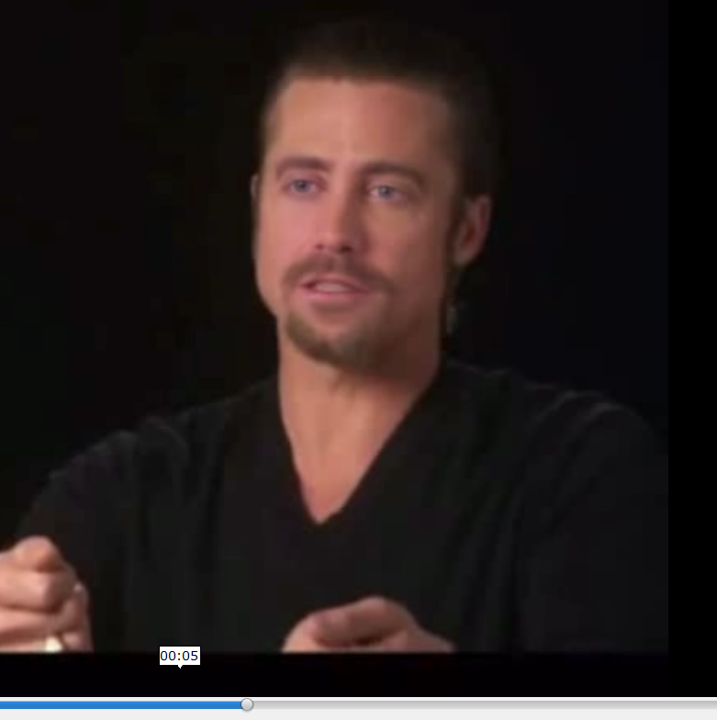
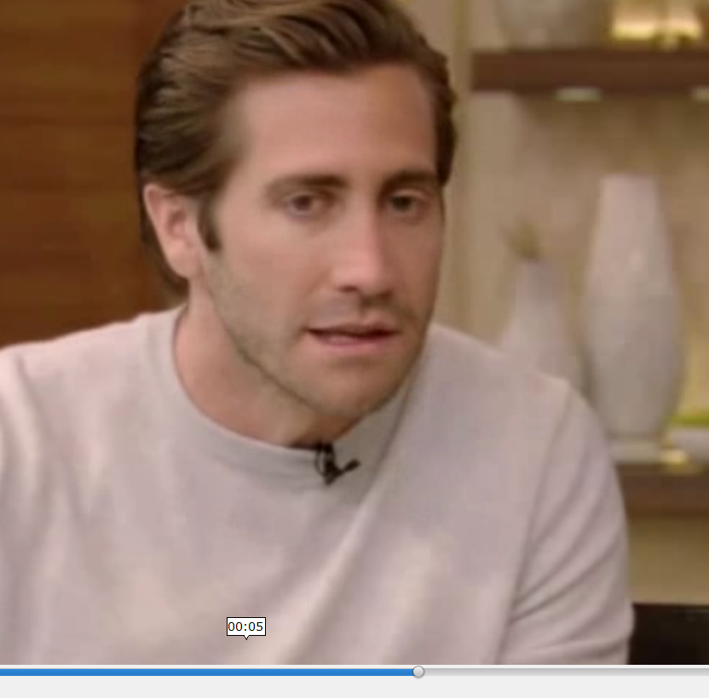
Sample screenshot of the video to represent the dataset
REAL
FAKE

Slide 15
Results and Discussion
CNN-LSTM
Ensembling models (New Model)
cnn_lstm_model(),xception_lstm_model(),bidirectional_lstm_model()
Tranfer learning :Xception
Tranfer learning: Xception as base and Vgg 16 (New Model)
CNN_lstm with attention layer(New Model)

Slide 16

CNN-LSTM
CNN effectively identifies visual distortions such as artificially created textures or shadows by extracting spatial characteristics from video frames. In order to identify minute variations in motion or temporal irregularities, LSTM records sequential information across frames. However, LSTM is unable to extract fine-grained spatial data, while CNN is unable to model temporal connections on its own. For video-based applications like deepfake detection, the hybrid model is quite successful since it combines CNNs for spatial analysis with LSTMs for temporal interactions. TensorFlow/Keras. TimeDistributed wrapper makes it possible to process sequential frame data with ease, which makes the framework perfect for CNN-LSTM architecture implementation.

Slide 17

ENSEMBLING MODEL
CNN-LSTM: Identifies motion irregularities and visual artifacts by extracting spatial information and temporal relationships.
Xception-based CNN-LSTM: This type of CNN combines LSTM for temporal patterns with the Xception model, which is a potent pre-trained feature extractor for in-depth spatial analysis.
Bidirectional LSTM:For more thorough temporal modeling, bidirectional LSTM records both forward and backward temporal dependencies.
Through the integration of several viewpoints, including spatial, temporal, and bidirectional analysis, ensembling improves model reliability in deepfake detection. It lessens the danger of depending just on the shortcomings of one model. The ensemble guarantees improved generalization for identifying deepfake anomalies across diverse datasets by combining CNN-LSTM, Xception-LSTM, and Bidirectional LSTM.
For complex applications like deepfake identification, where artifacts may show subtly and inconsistently between frames, this approach is particularly helpful.

Slide 18

Transfer learning :Xception
Leverages Pre-trained Knowledge: The Xception model has a solid basis for feature extraction because it has already been trained on millions of photos. Robust spatial information are extracted from every video frame using the Xception model.It is possible that deepfake datasets are not always large. Even with a small amount of labeled data, the model can generalize more effectively because to transfer learning.Each video frame is processed by the CNN-LSTM model based on Xception, which uses the Xception architecture to extract spatial features. Then, in order to more successfully identify deepfake films, LSTMs record temporal irregularities (such as abnormal motion between frames).

Slide 19
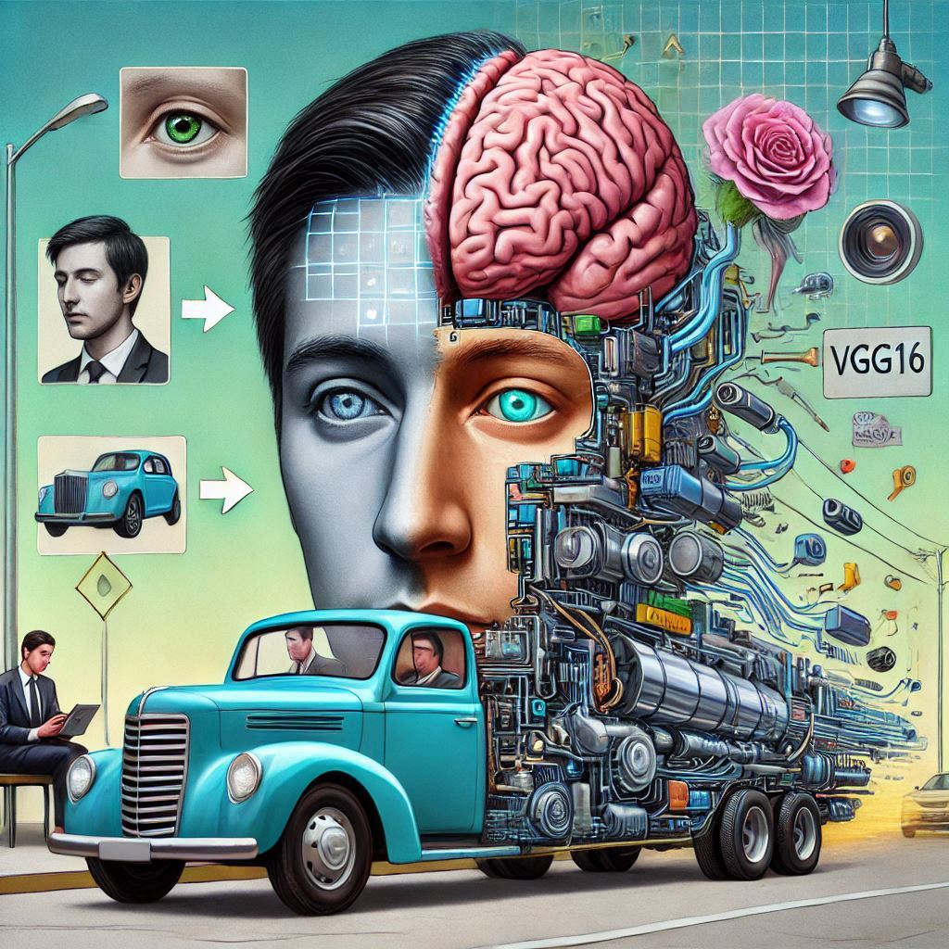
Transfer learning :Xception and VGG16
A potent convolutional neural network (CNN), Xception is renowned for its remarkable ability to extract fine-grained spatial data. It serves as the framework for obtaining features from every video frame in this configuration. As a branch model, VGG16: Xception is utilized together with VGG16, a deep CNN architecture, to improve feature extraction through the usage of a complementary branch. The goal of the combination is to capitalize on each model's advantages. LSTM for temporal analysis: LSTM examines sequential relationships between video frames to acquire temporal information essential for detecting deepfakes, following the extraction of spatial features by Xception and VGG16.

Slide 20
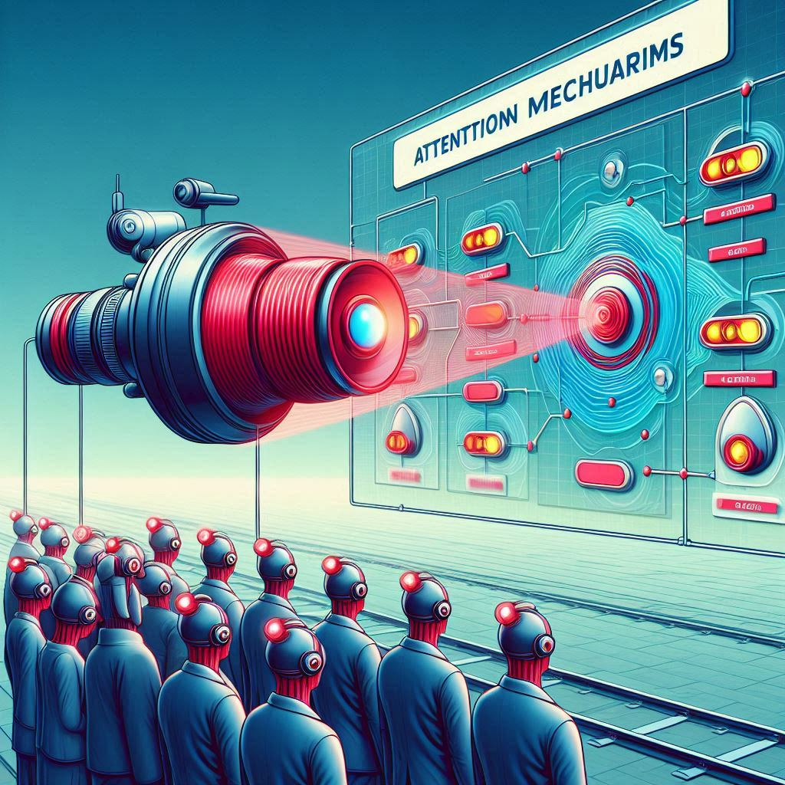
ATTENTION MECHANISM
CNN + LSTM: Deepfake videos with texture inconsistencies or artificial lighting are examples of fine-grained spatial features that CNN is excellent at extracting from individual frames. In order to catch temporal irregularities, like sudden changes in expressions or mismatched motion, LSTM examines the frame sequence.
Attention Mechanism By concentrating on important aspects and disregarding unimportant details, the attention mechanism improves the interpretability of the model. Draws attention to important temporal and spatial clues that traditional CNN-LSTM models frequently overlook, such as strange motions or inconsistent frames. Aids the model in determining which frames in a sequence or which parts of a frame are essential for classification.

Slide 21
Performance Analysis
Algorithm | 10 epochs | 50 epochs | 100 epochs | 200 epochs
CNN-LSTM | 38% | 54%(5 minutes) | 55% (8.7 hours) | 59% (14 hours 25 minutes)
cnn_lstm_model, xception_lstm_model bidirectional_lstm_model | 47.50%(12 minutes) 55.00% (19.35minutes) 52.50% (18.15 minutes) | 47.50% (1 hour 6 minutes) 45.00%(1 hour 42 minutes 30 seconds) 52.50%(1 hour 30 minutes) | 56% (12 hours) | 58% (20 hours)
Tranfer learning with Xception as a base | 58.75% (15 minutes) | 70.63%(29 minutes 10 seconds) | 70% (6 hours) | 70% (10 hours)
Xception as base and Vgg 16 as a branch | 58.75%(30 min 30 second) | 70%(2 Hours : 36 Minutes) | 71%(8 hours ) | 72% (11 hours)
CNN_LSTM and Attention Layer | 48%(17 Minutes : 20 Seconds) | 50.63%(1 Hour : 25 Minutes | 56%(4 Hours : 11 Minutes : 40 Seconds) | 51%(8 hours: 50 Minutes)

Slide 22
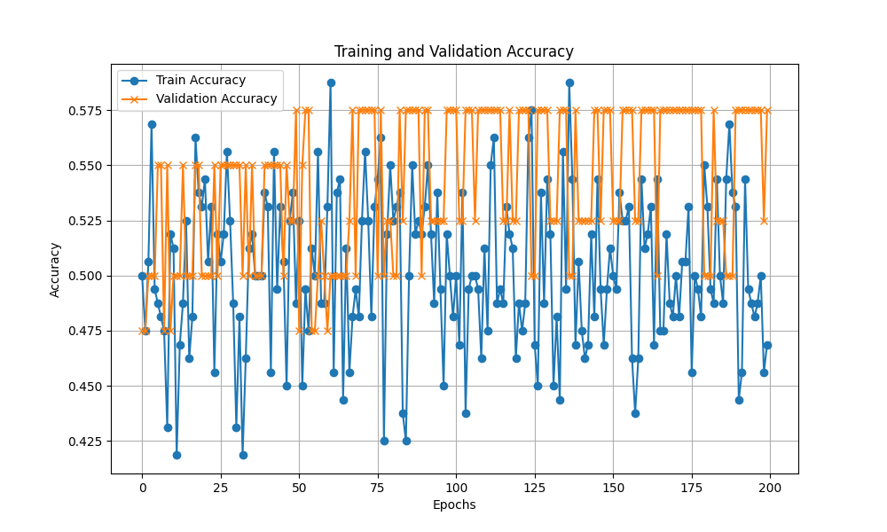
Graphs
CNN-LSTM
The blue line represents training accuracy.
The orange line represents validation accuracy.
It remains relatively stable but low (around 0.5–0.55), indicating that the model is not generalizing well to unseen data.

Slide 23
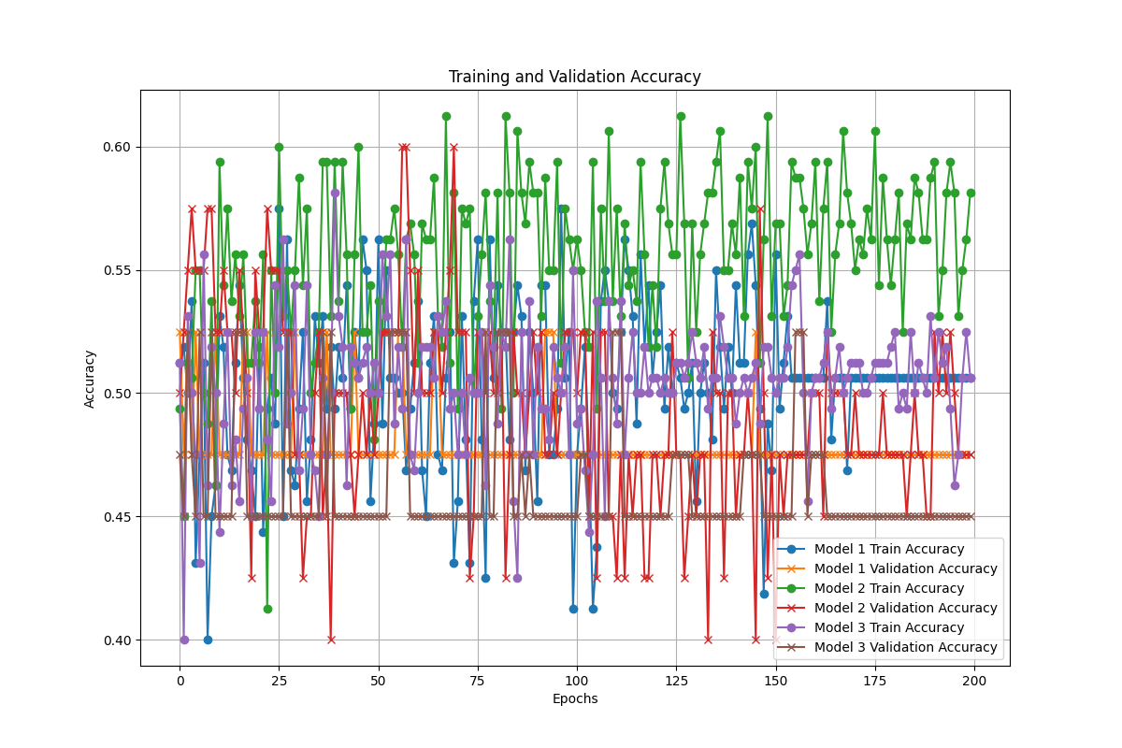
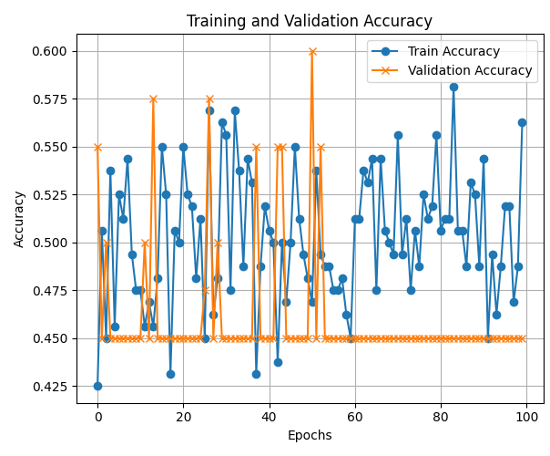
Graphs
Ensembling Model
Model-Specific Insights
Model 1:
  Shows steady improvement in training accuracy over time, but validation accuracy remains erratic and does not significantly improve.
Model 2:
  Performs poorly on both training and validation sets, suggesting it might not be learning effectively from the dataset.
Model 3:
  Achieves the highest training accuracy among the three but has validation accuracy fluctuations similar to Model 1, indicating overfitting.

Slide 24
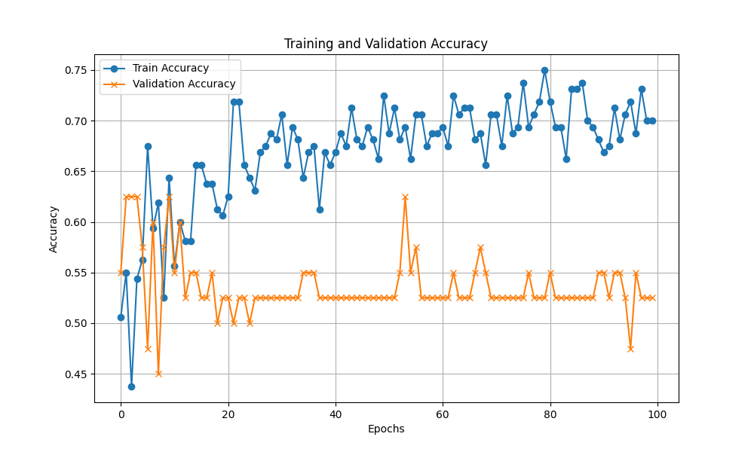
Graphs
Transfer learning
Pretrained Features:
While Xception is a powerful feature extractor, its pre-trained weights might not fully align with the task of deepfake detection, requiring fine-tuning of some layers. Xception is good for hierarchical feature

Slide 25
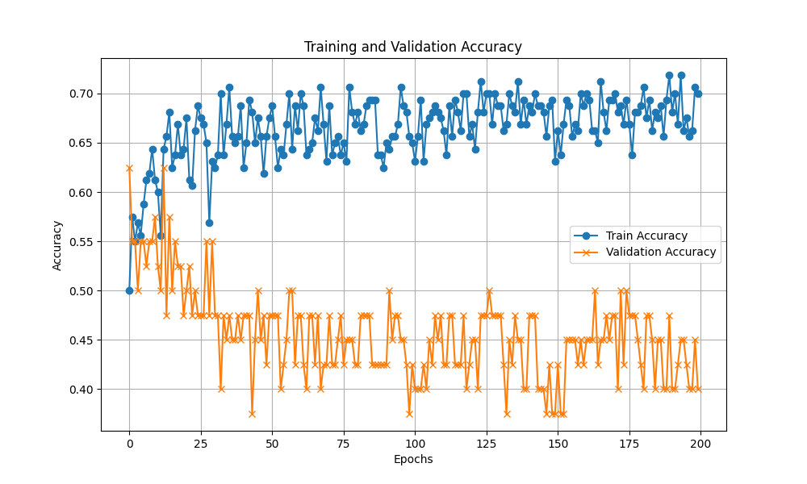
Graphs
Hybrid Transfer learning
While Xception is a powerful feature extractor to enhance the model and make a model more powerful VGG16 was added in the Transfer learning.
By combining the state-of-the-art (Xception) and the classic (VGG16), this hybrid architecture creates a powerful and versatile transfer learning framework.

Slide 26
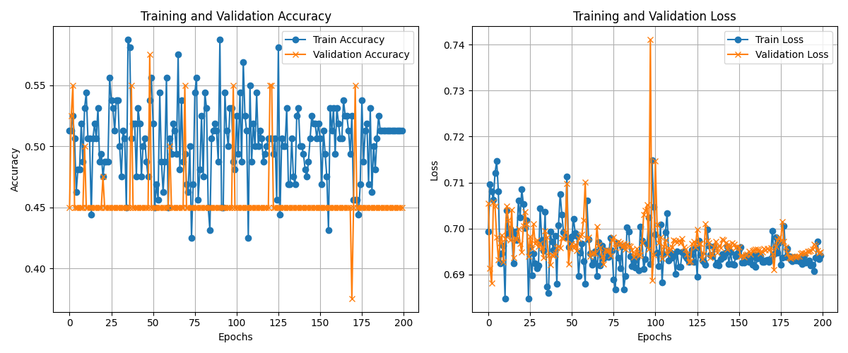
Graphs
Attention mechanism
Focus on Important Features: In deepfake detection, attention can prioritize regions of the image or frames in a video where manipulations are likely to occur (e.g., facial areas or subtle inconsistencies).
Reduce Noise: By focusing on relevant spatial and temporal features, the model avoids irrelevant information that could degrade performance.
Enhance Interpretability: Attention mechanisms provide insights into which parts of the input data influence the model’s decisions.

Slide 27
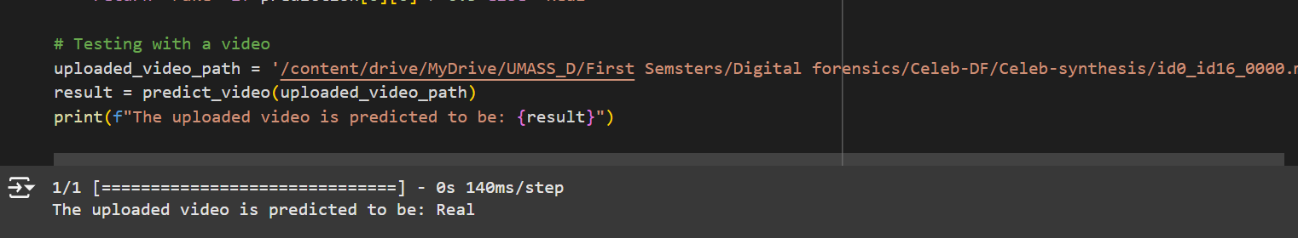
OUTPUT

Slide 28
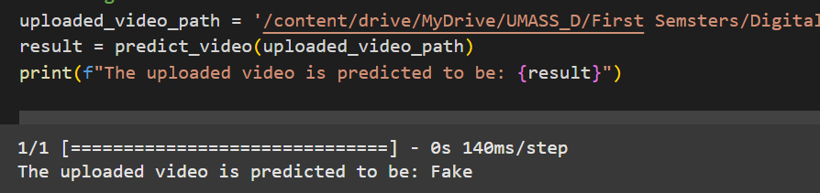

Slide 29
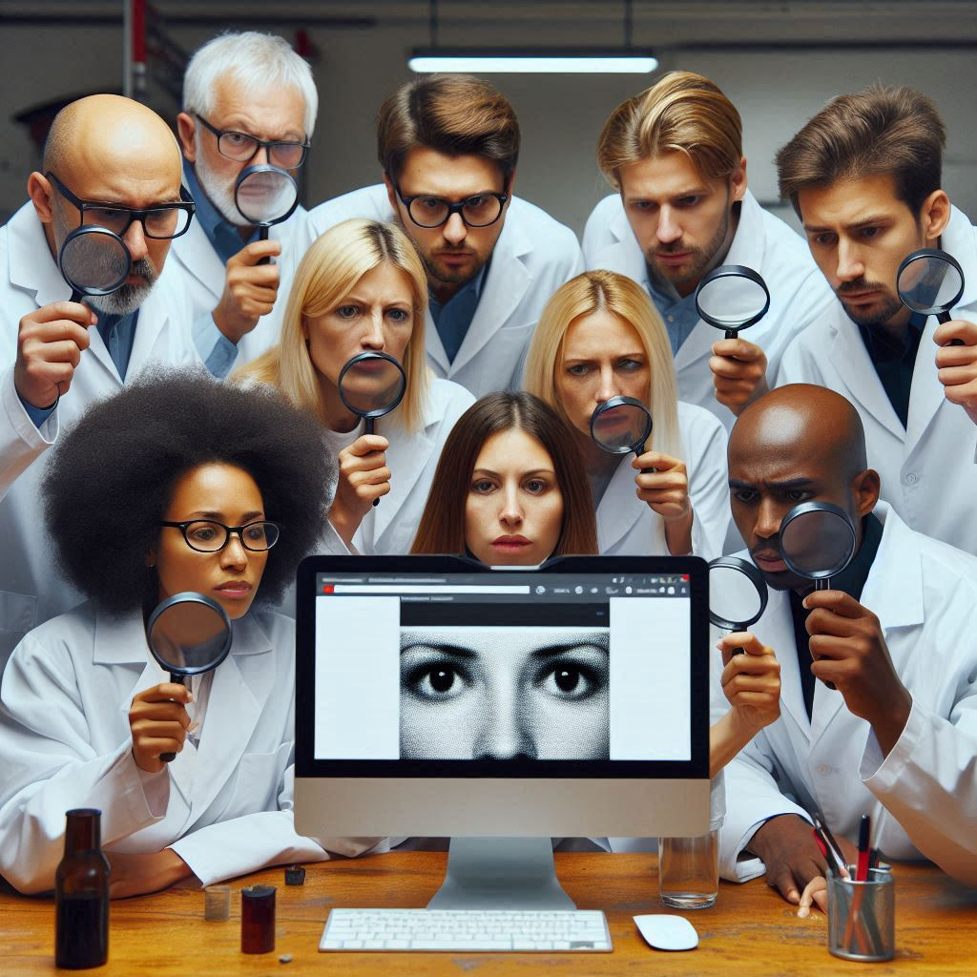
Conclusion
This study presents a scalable and effective framework for detecting deepfake videos, leveraging the combined power of CNNs, LSTMs, and attention mechanisms. By analyzing spatial and temporal features, the proposed model achieves high accuracy in distinguishing between real and manipulated content. The results validate the effectiveness of deep learning in addressing the growing threat of deepfake technology. This research contributes to the field of digital forensics by offering a robust tool for preserving media authenticity and combating the misuse of generative technologies.

Slide 30
Future Enhancement
By studying more on transfers learning and pretrained model we implemented for the better accuracy
Implementation in advance level of data augmentation to improve the accuracy
Adding more features to predict it and also combine all the process and convert to API or website

